Slide 1



IN COOPERATION WITH SIGMAN!
Made by: Rasmus Leppäniemi ja Juho Marjakoski

Slide 2
Core Concept
Focused on [core mechanic or theme, e.g., procedural housing]​
Built using Unity, Blender, and C#​

Slide 3

Key Features
► Feature 1
► Feature 2
► Feature 3
► Feature 4

Slide 4
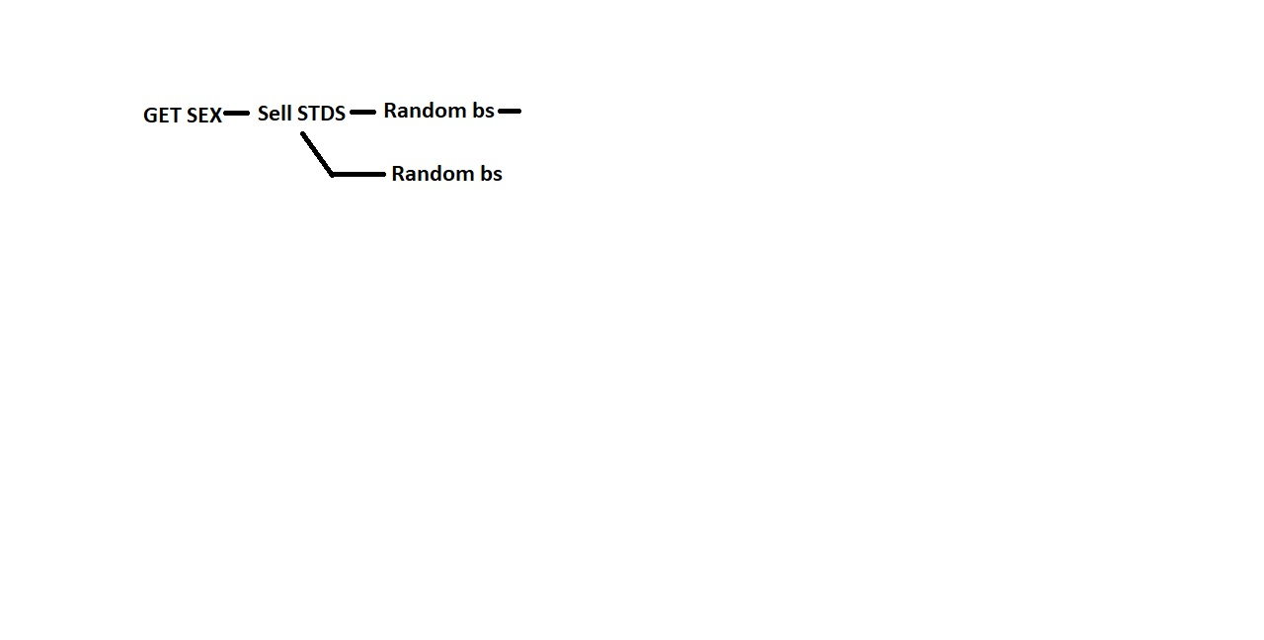
Gameplay loop

Slide 5
Thank you!

